Slide 1


Fantasy Football Machine Learning
By: Michael, Demi & Jaime

Slide 2
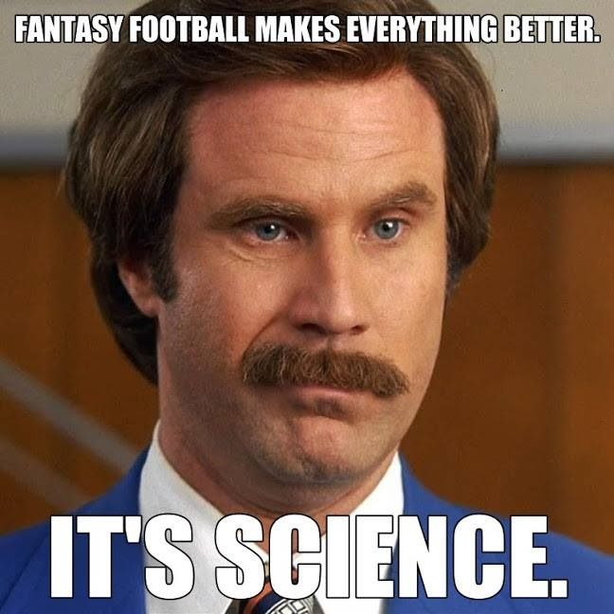
What is Fantasy Football?
At its most basic, fantasy football is a game in which football fans use their knowledge of the sport to compete against each other in formats that relate to the actual performance of professional football teams. The goal of the fantasy football player is to select (draft) which players will have the highest statical outputs each week.
What if we used historical performance to predict top performers at each position?

Slide 3
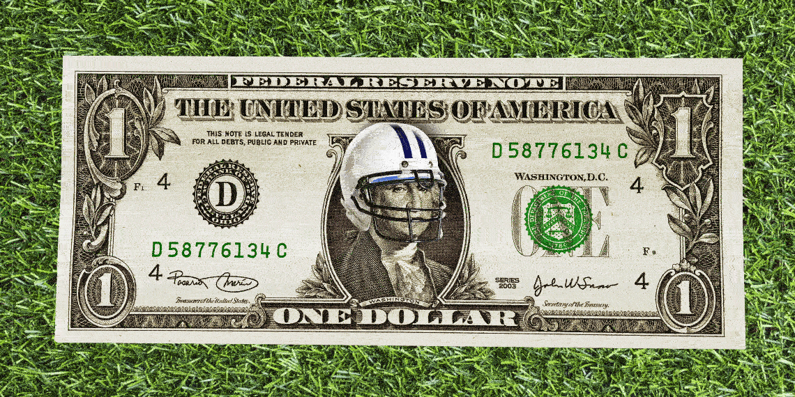
Fantasy Football History
Fantasy gridiron football emerged in 1962 when Bill Winkenbach, then part owner of the Oakland Raiders football team, gathered with some friends in a New York City hotel, and together they created the first fantasy football league, which was dubbed the GOPPPL (Greater Oakland Professional Pigskin Prognosticators League)
Since the first league, fantasy football has evolved into an industry of over $22 billion as of 2021. Due to the growth of popularity and easy access to data, smart fans have turned to tools to provide competitive advantages. There is an opportunity to provide endless machine learning models to players.

Slide 4
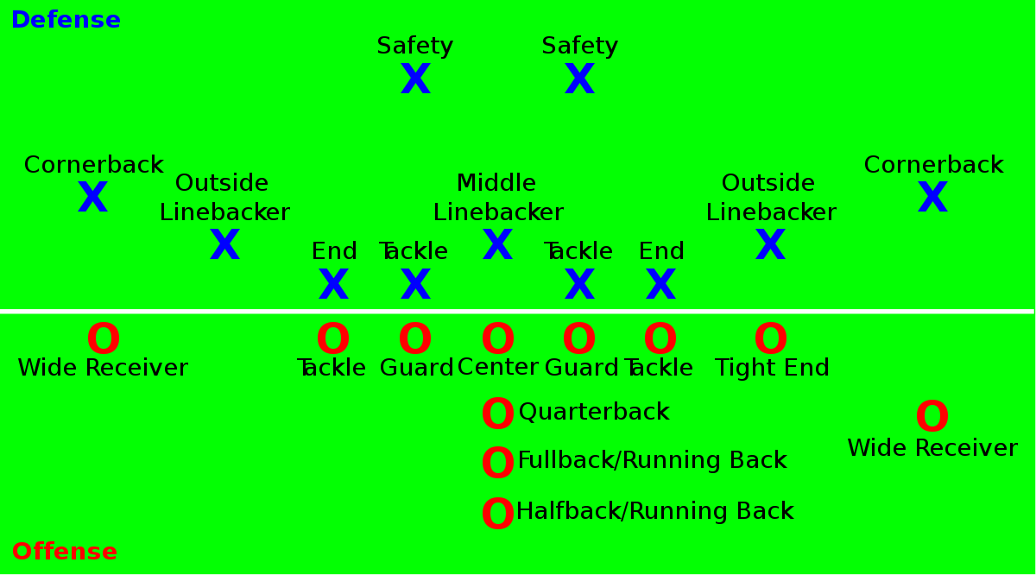
Positions
Our machine learning analysis is designed for the following position
  Quarterback
  Wide Receiver
  Running Back
  Tight End

Slide 5
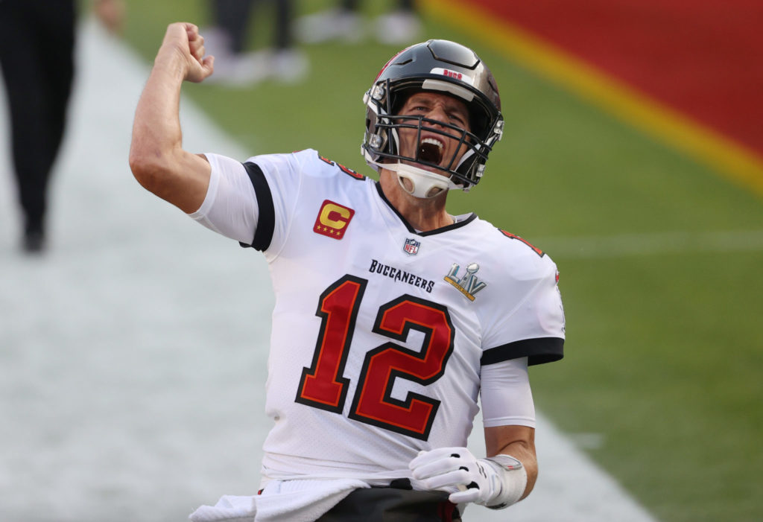
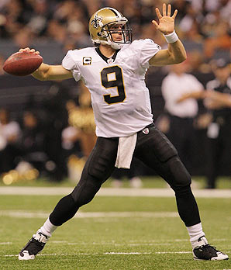
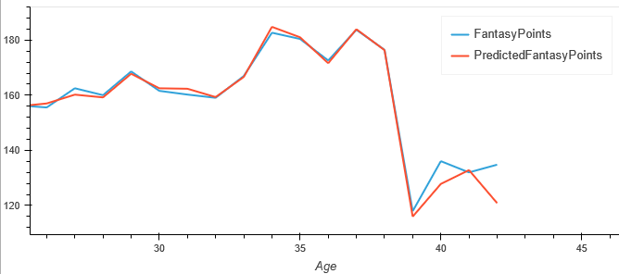
Quarterback
What is the premium age to target when drafting a QB?
Our model predicts the QB you should target in your draft is between the ages of 28 and 34 years old

Slide 6
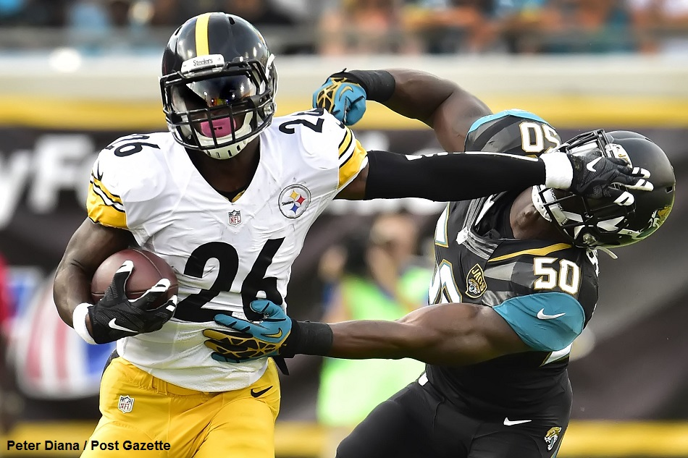
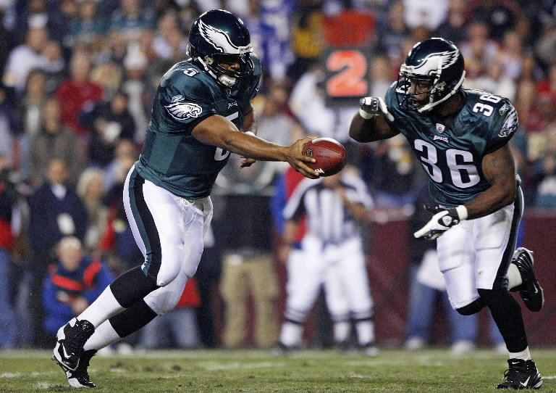
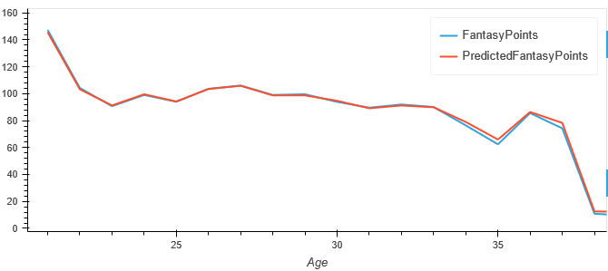
Running Back
What is the premium age to targe when draft a RB?
Our model predicts the RB you should target in your draft is between the ages of 21 and 23 years old.

Slide 7
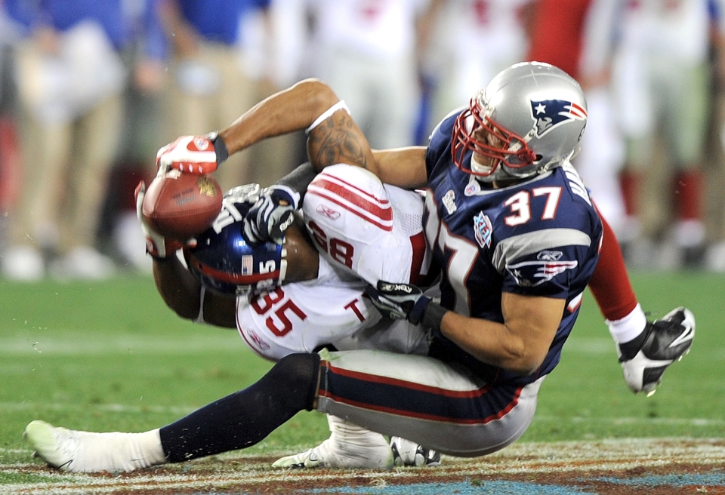
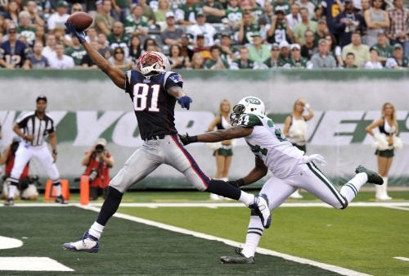
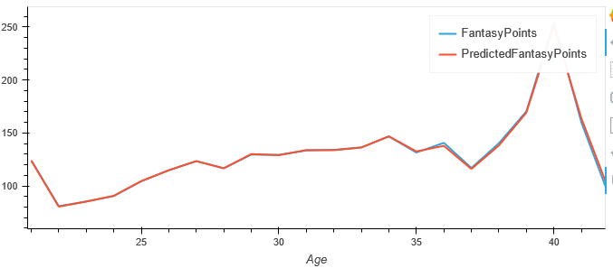
Wide-Receiver
What is the premium age to target when drafting a WR?
Our model predicts the WR you should target in your draft is between the ages of 26 and 34 years old.
These are data outliers skewed by small sample size for that age

Slide 8
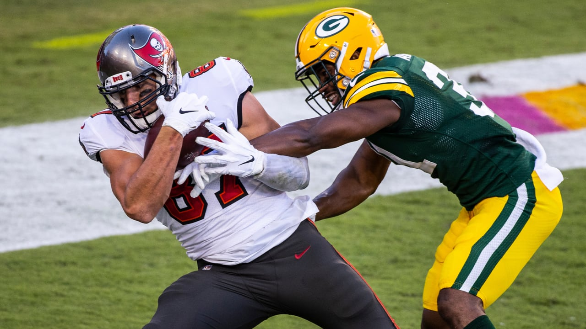
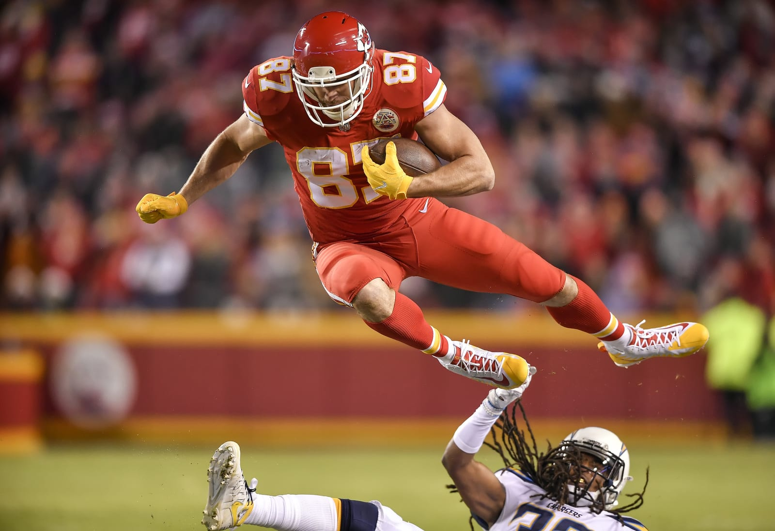
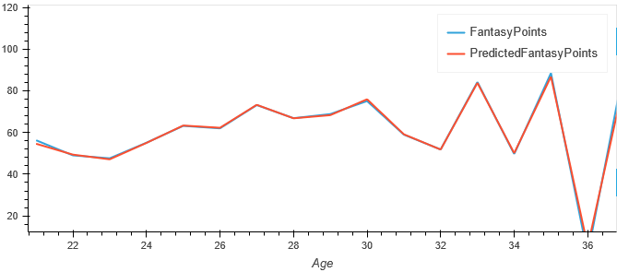
Tight End
What is the premium age to target when drafting a TE?
Our model predicts the TE you should target in your draft is between the ages of 25 and 30 years old.
These are data outliers skewed by small sample size for that age

Slide 9
The End
Now we share our notebook!
Demi, Jaime and Michael
Group 5

